Slide 1
AYITI ANALYTICS
“Determinants of abortion choice: The Case of Women Aged 15-49.
Presenter: Chrismond Versailles

Slide 2

Table of methodology
OVERVIEW OF KEY IDEAS
Problem and the audience.
Results Recommandations Conclusion
References & Appendices

Slide 3
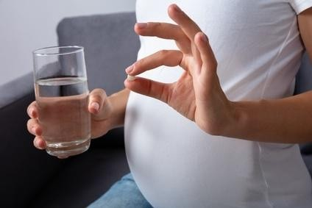
Problem and the audience.
Abortion is the interruption, before its term, of the gestation process. Abortion is a topic of concern to demographers and health care providers, as unsafe abortion is a major cause of maternal mortality (WHO, 2011), and the health consequences of abortion remain a major issue in many countries.
The audience concern by this problem:
- All women.
- Public authorities.
- Ministry of Public Health and Population.
- International organizations/donors and NGOs working in the field of reproductive health and human rights, especially women's rights.

Slide 4
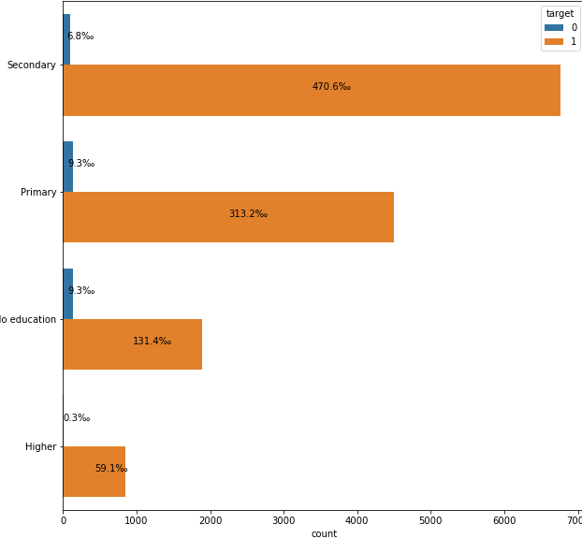
Results
.

Slide 5
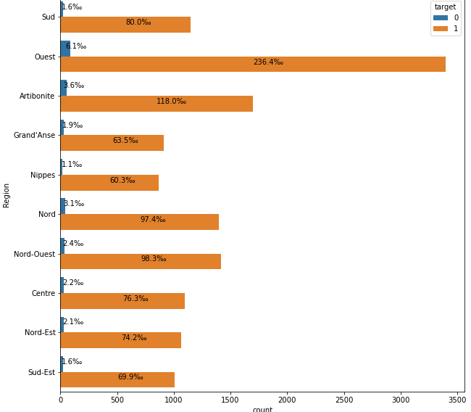
Results
The west department is the region where there is the most abortion to know 470.6‰ then comes Artibonite then the North-west

Slide 6
Results
This graph highlights the religion and education level of those who had abortions.

Slide 7
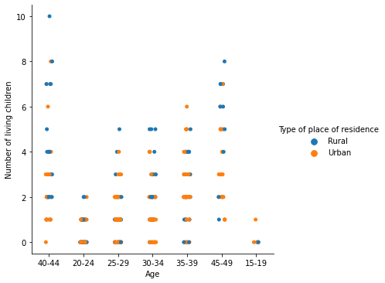
Results
Women who have already had an abortion in rural areas have more children than in urban areas and the older the woman, the more children she
has.

Slide 8
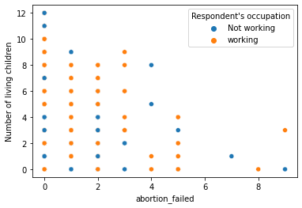
Results
There is a relationship between the number of failed abortions and the number of living children; this relationship is proportional.

Slide 9
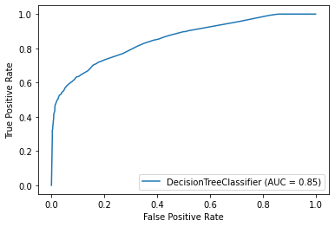
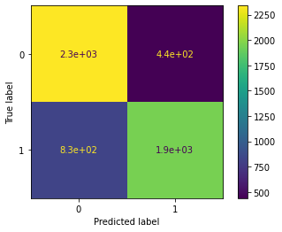
Machine Learning model
Decision Trees (DTs) are a non-parametric supervised learning method used for classification and regression. The goal is to create a model that predicts the value of a target variable by learning simple decision rules inferred from the data features. A tree can be seen as a piecewise constant approximation.
We have chosen this model because it allows us to explain the decision to abort in a simple way according to the factors that influence this decision. It allows us to predict whether there will be an abortion with an accuracy of 78% and requires less than two seconds.

Slide 10
Recommendations
GLOBAL PERSPECTIVE
1) Comprehensive sexuality education that includes medically accurate information about abstinence and contraception especially after primary school and also in a religious environment.
2) Insurance coverage of and public funding for family planning services.
3) Greater access to emergency contraception (which prevents pregnancy and does not cause abortion).
4) Programs that curb domestic violence and sexual abuse.

Slide 11
Conclusion
Top features
- Religion
- Education level
- The area
- Current marital status

Slide 12
Talk to Us
Mailing Address
39,Delmas 75, Rue Michel.
Phone Number
(509) 4923-5765
E-mail Address
Chrsversailles@gmail.com

